Slide 1
Clash of Code
By Nathan Sinclair

Slide 2
Contents
How I attained quality goals
What did the final result look like?

Slide 3
How did i attain quality goals?
Perfectly formatted Code
I used jslint on the specs and src ticking the flags ES6, and for statement. The describe() and it() functions were not known to jslint so i had to excuse those.

Slide 4
Simplest thing that works
I have provided model answers to each question
I have made use of the previous functions in my model answers
The questions that did not add any classes/functions have empty source files

Slide 5
Useful testing which means lots of data variants and finds the bugs
Set up functions for parsing of data (when input is received)
Set up clauses for various functions to determine right input (e.g calculateSum should return a number)
Naming of functions is what it does. This meant changing some functions (a function should only have one purpose, which is explained in the name of the function)

Slide 6
Some tests are supposed to fail - e.g calculateSum should fail if it does not return a number.
Some should pass - e.g determining positive, negative or 0, the outcome is always that the function should return something that is valuable to the function that called it. (ie. true, false)

Slide 7
The ones for the testing of numbers or letters, I have gone with a false for invalid data and for appropriate data to return the data. I had decided that when making input functions in the controller that it would be running these functions, and you could produce a message to input again if it was invalid.
Tests don’t cover the input apart from the functions that I’ve set up which would test the input

Slide 8
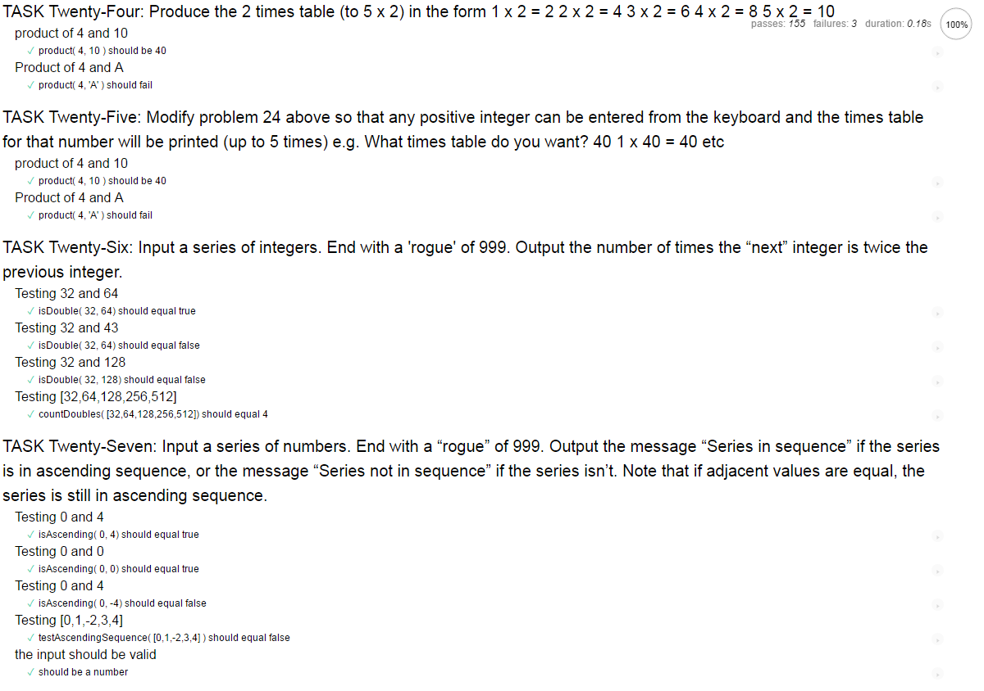
What did the final result look like?

Slide 9
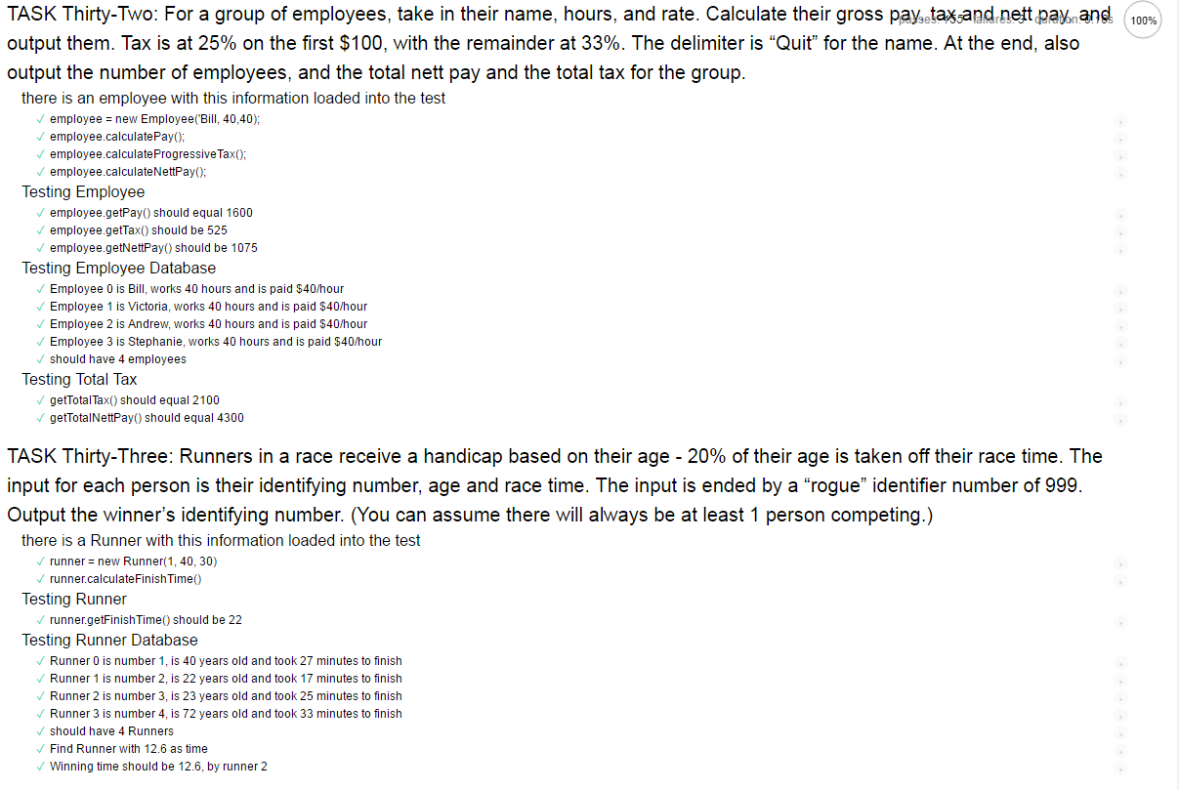
What did the final result look like?

Slide 10
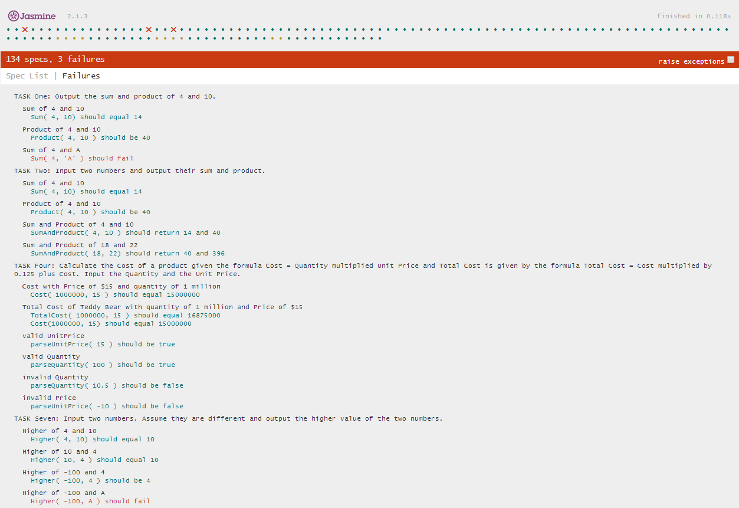
What did the final result look like?

Slide 11
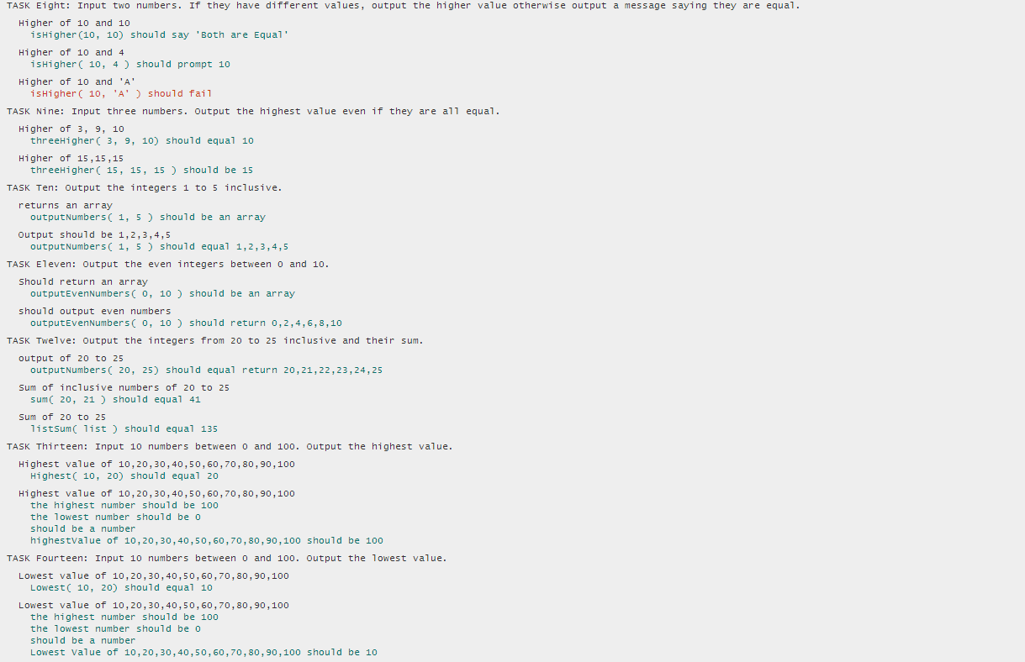
What did the final result look like?

Slide 12
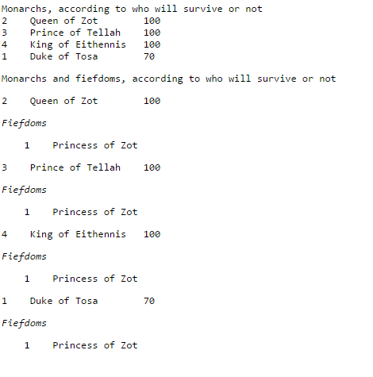
What did the final result look like?

